Slide 1
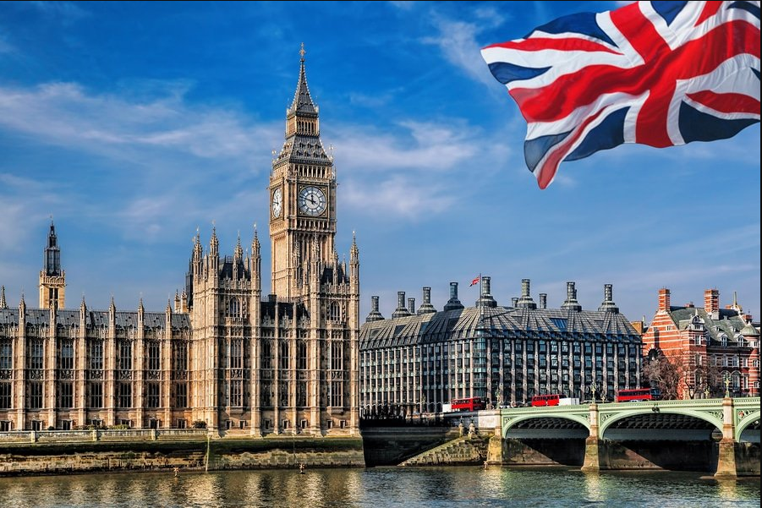
Identify Customer Geography
@ProWidget Systems
By: Anaclet Sado Fokam
Notes:
“Today I’m sharing a short, data-driven analysis to understand where our revenue is coming from and identify cities that may be underserved or untapped.”

Slide 2
Agenda

Slide 3
Executive Summary
London accounts for 21% of total revenue out if 76 cities
54% of total revenue came from unrecognized addresses
No large city is structurally underserved
Clear opportunities for targeted commercial activation
Notes:
“This project helps clarify our geographic performance and highlights both strong markets and visible weak points.”

Slide 4
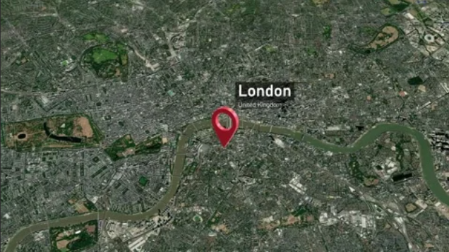
Problem Formulation
Identify regional disparities in customer spending across the United Kingdom by comparing to London-based customers.
Notes:
“My goal was to turn limited data into meaningful insights that directly support board decisions.”

Slide 5
Data Requirement
Internal source
External source
List of cities (HTML) - GOV.UK
Revenue aggregate by client
Notes:
The dataset was limited because they hadn’t have the dates (which is one of the important field for any analysis), though it contained enough information to create a robust city-level analysis.

Slide 6
Data Preparation
Splitted UK city names within addresses
Standardized UK city names
Grouped customers by city
Created 3 functional categories:
LONDON
OTHER
REST OF CITIES
Notes:
“City normalization was essential because incorrect mapping would distort the insights.”

Slide 7
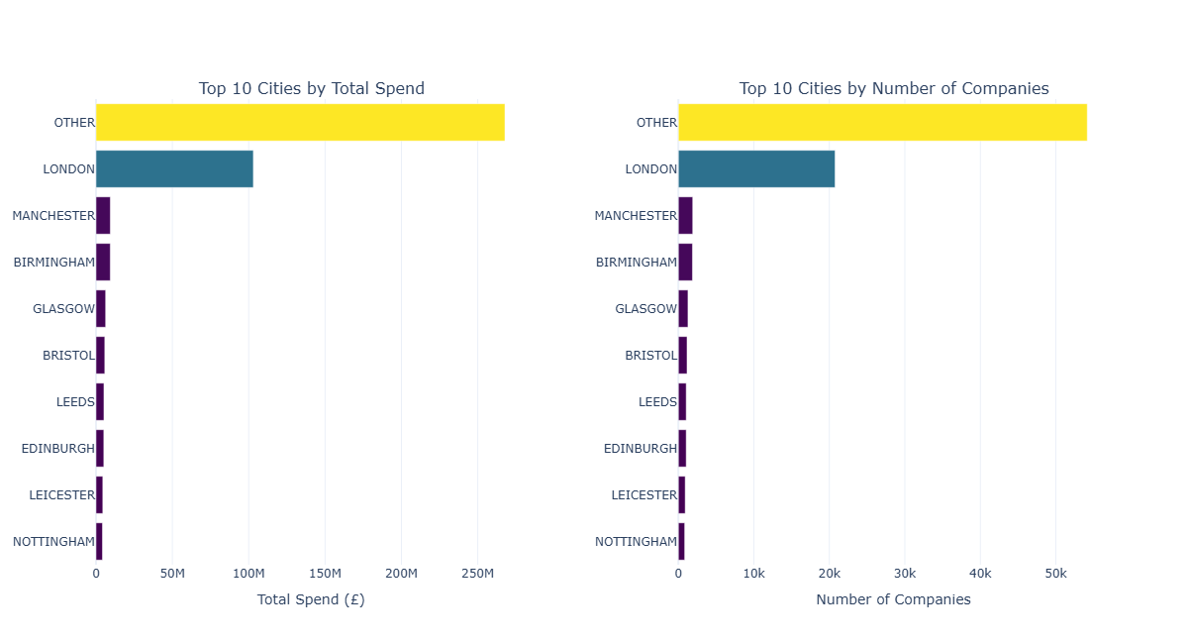
Revenue Concentration
Key Insight:
LONDON and OTHER dominate revenue
Next cities contribute much smaller, stable volumes
Notes:
“We quickly see a concentration of revenue in only two major groups.”

Slide 8
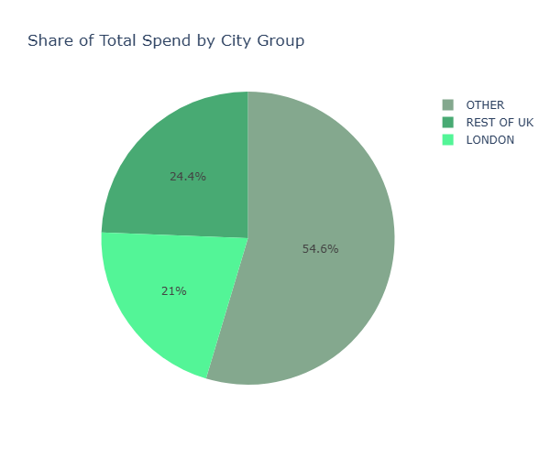
Analysis: LONDON vs others
LONDON alone represents 21% of revenue
Notes:
“This highlights both the market potential outside London and the need to break down the 'OTHER' category.”

Slide 9
City-level Metrics
Metrics help companies measure and evaluate its performance
Company Share
Market size
Spend Share
Revenue contribution
Proportion of the spend in the overall
Spend by company
Adoption level
Proportion of the number of company in the overall
Average spend
Notes:
“These indicators allowed me to understand not only revenue, but also engagement.”

Slide 10
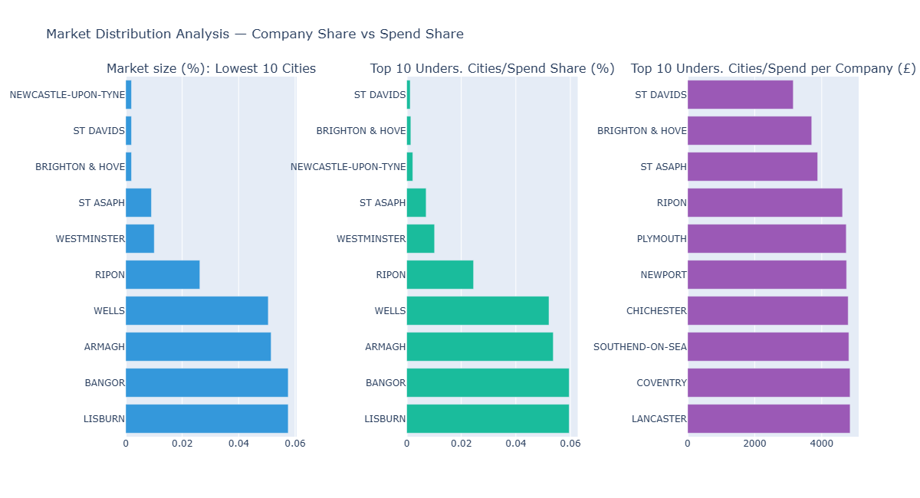
Underserved Cities
To seek more opportunities
Notes:
First logic is to see the lowest cities based on 3 KPIs Findings: Cities consistently underperforming across metrics: ➡️ ST DAVIDS ➡️ BRIGHTON & HOVE ➡️ ST ASAPH ➡️ RIPON ➡️ NEWPORT
These are micro-markets with customer presence but low spend.
“These cities are not large markets, but they do represent pockets of untapped potential.”

Slide 11
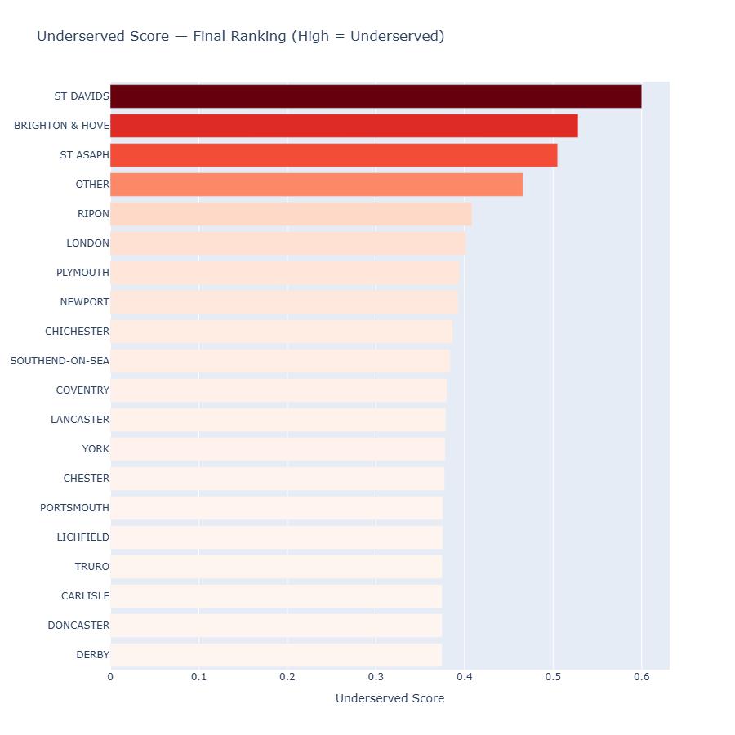
Underserved Cities
Highlights:
Most low-scoring cities are very small
No major city carries an engagement gap
London shows room to grow spend per company
Notes:
“The analysis clarifies exactly where our strengths and gaps lie.”

Slide 12
Conclusion
Revenue is highly concentrated
Some small cities present real opportunities
London remains a strong but improvable market
The ‘OTHER’ category requires breakdown and reclassification

Slide 13
Recommendations
1️⃣ Target the most underserved micro-cities
Sales, CS, and Marketing collaboration
2️⃣ Strengthen London engagement
Upsell + usage activation
3️⃣ Break down the “OTHER” bucket
Postcode-level cleanup
4️⃣ Monthly monitoring routine
Assign a “data champion” internally
Notes:
“These actions offer clear, low-cost ways to increase revenue and refine our geographic strategy.”

Slide 14
Additional Information
The report and details on the conducted analysis is available at the following link:
Anaclet12/Revenue-Performance-Analysis-with-Python: Extracting structured data from free text

